Slide 1

The Last Capture
Presentation 1
Team: Yibai Zhang & Vasco Pauthier

Slide 2

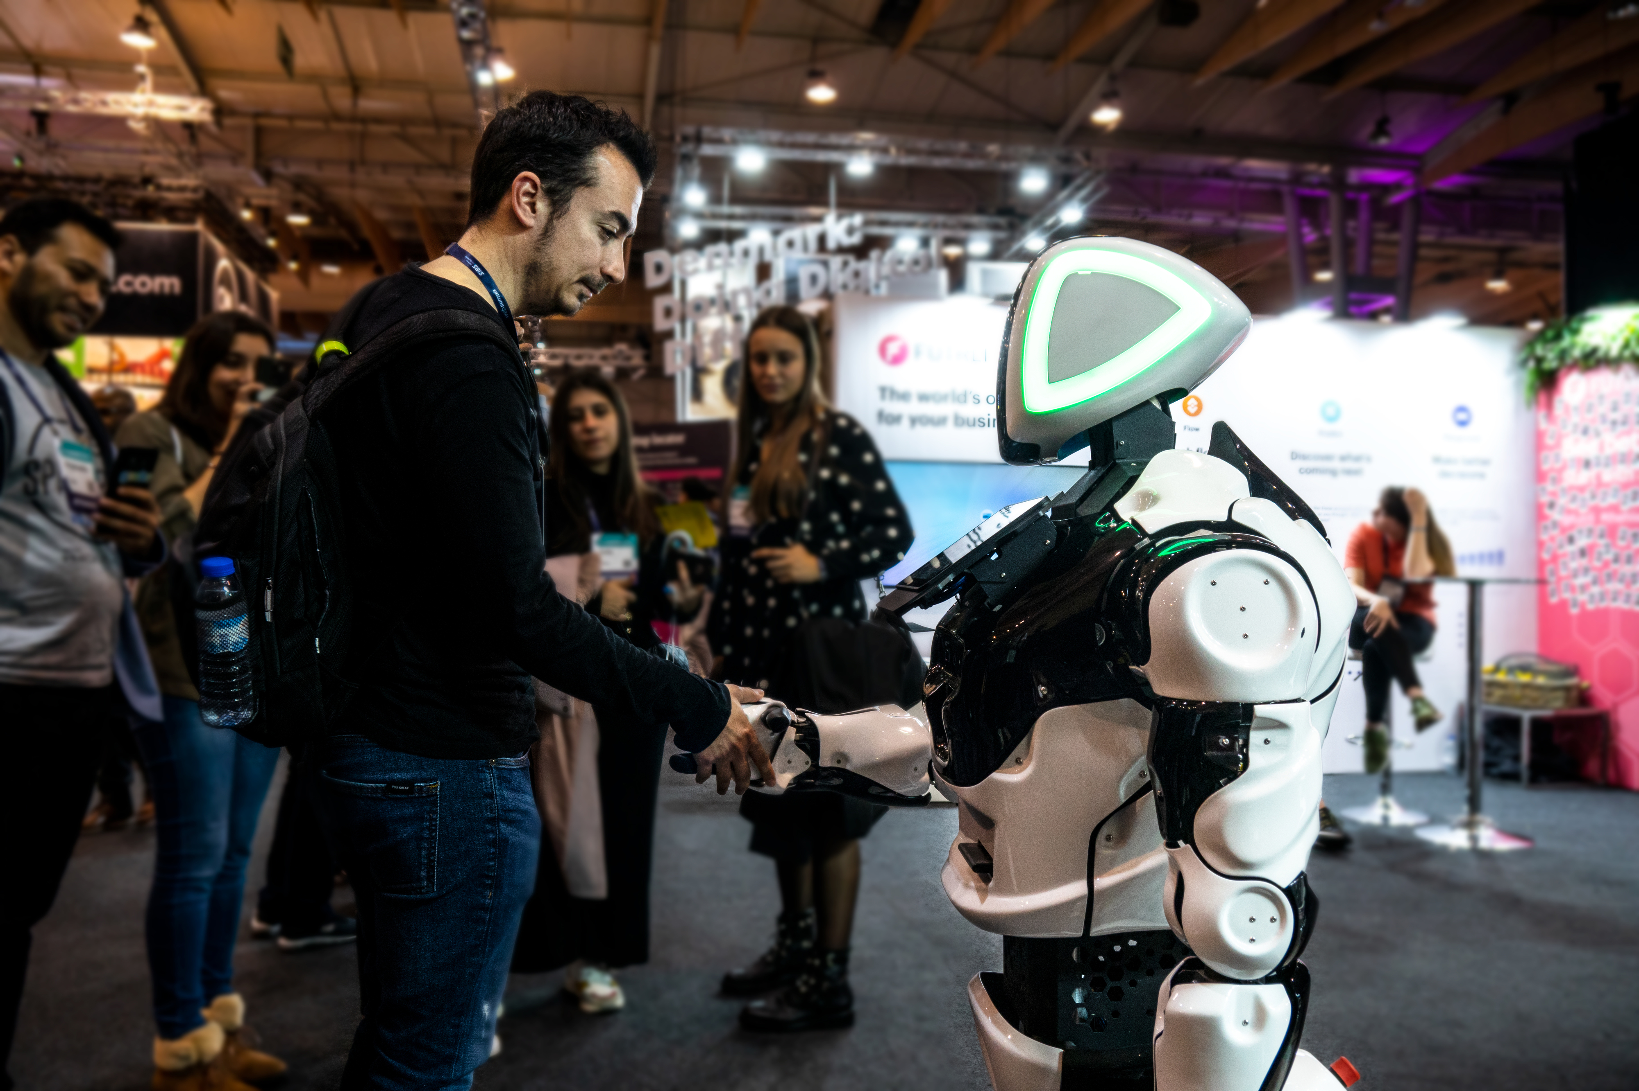
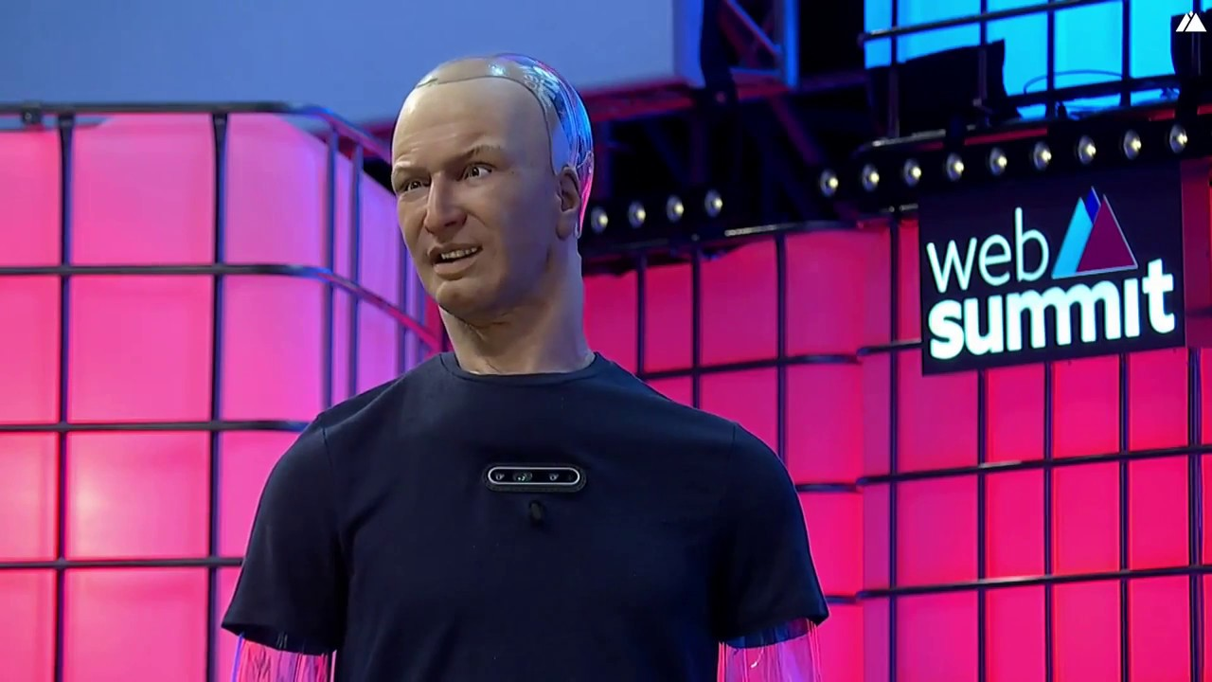
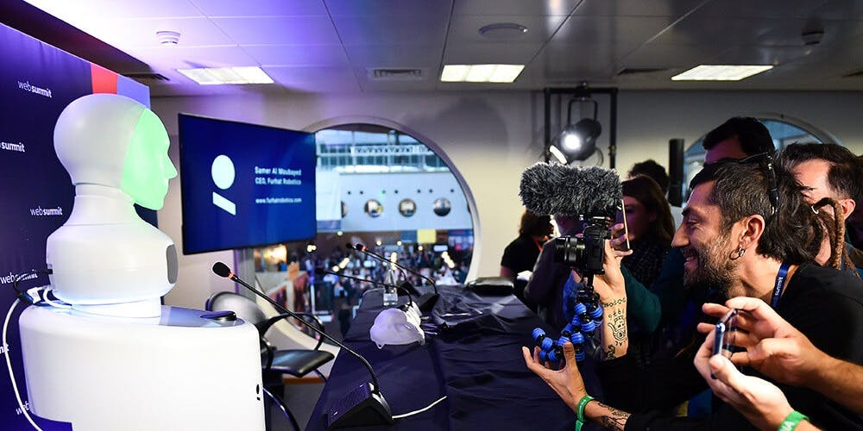
Client – Web Summit
Web Summit is an annual technology conference held in Lisbon, Portugal, considered the largest tech event in the world.

Slide 3
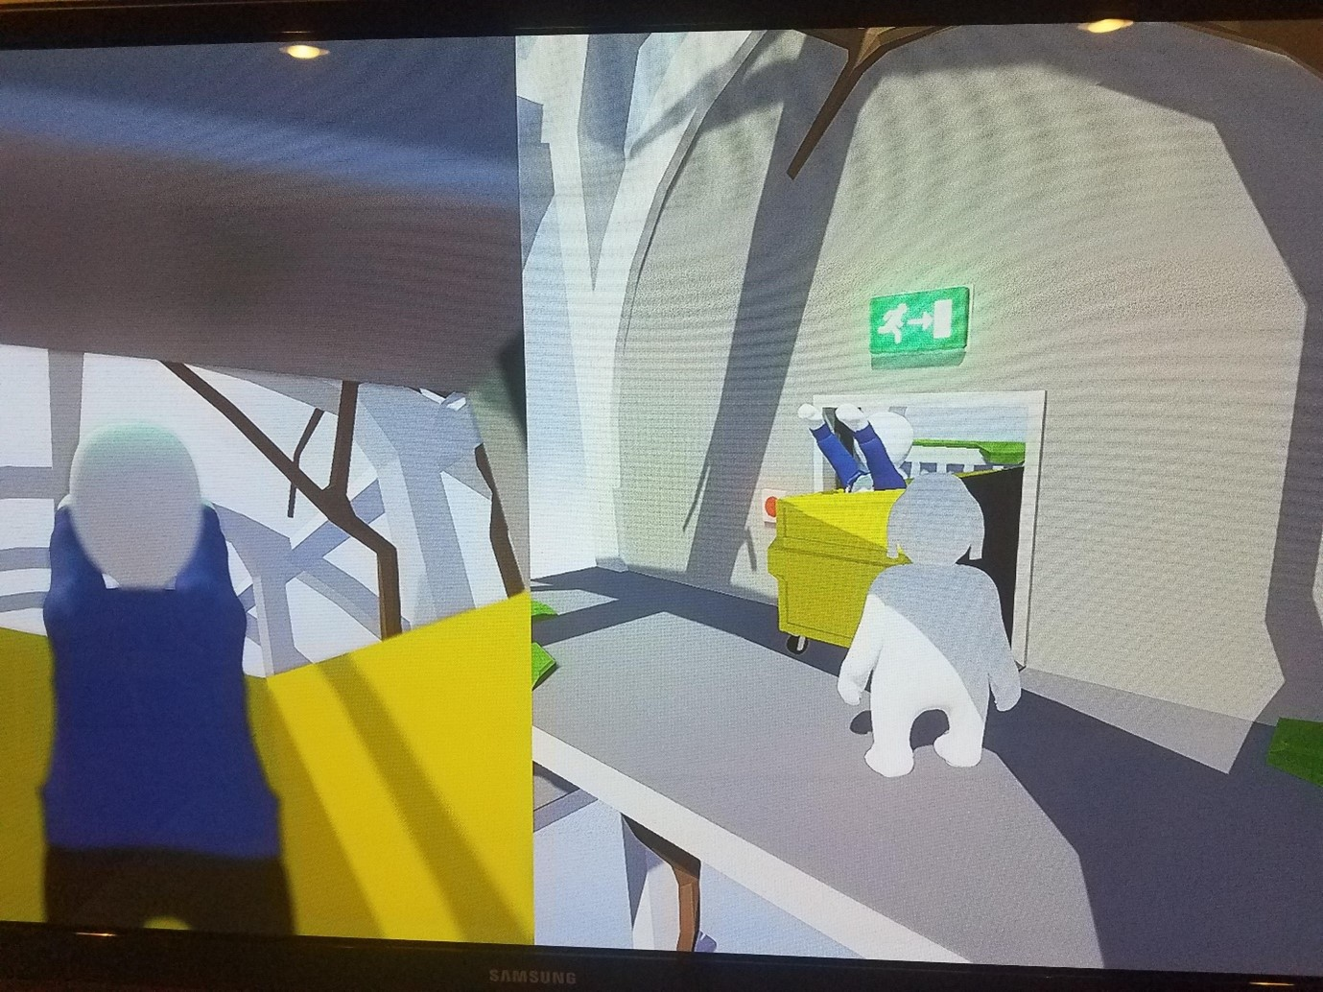
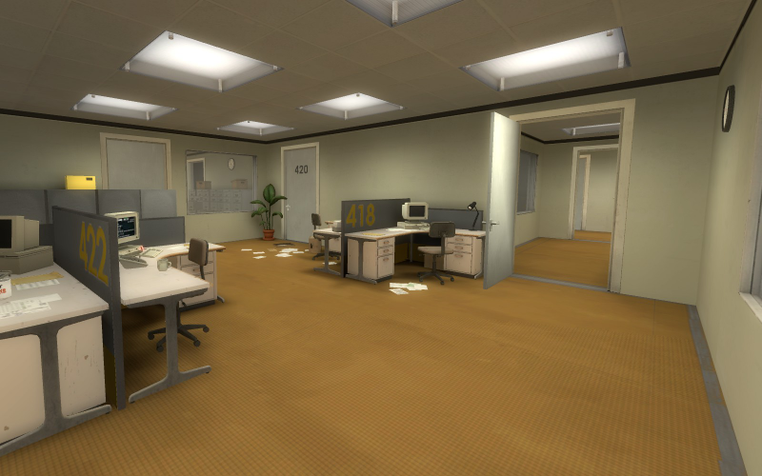
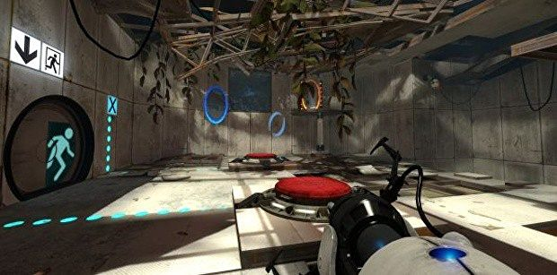
I
The Stanley Parable
Human Fall Flat
Portal 2

Slide 4
Story
Character
Reporter (main character, player control)
Newly developed AI Robot Prototype (enemy, chaser, malfunction ---> friend, protector)
Reporter is late for the web summit event, he need to go there quickly. But the power is shut down, he needs to find the power room to reboot it first. On the way, there is a dangerous robot chasing him but turns to a protector in the end…

Slide 5
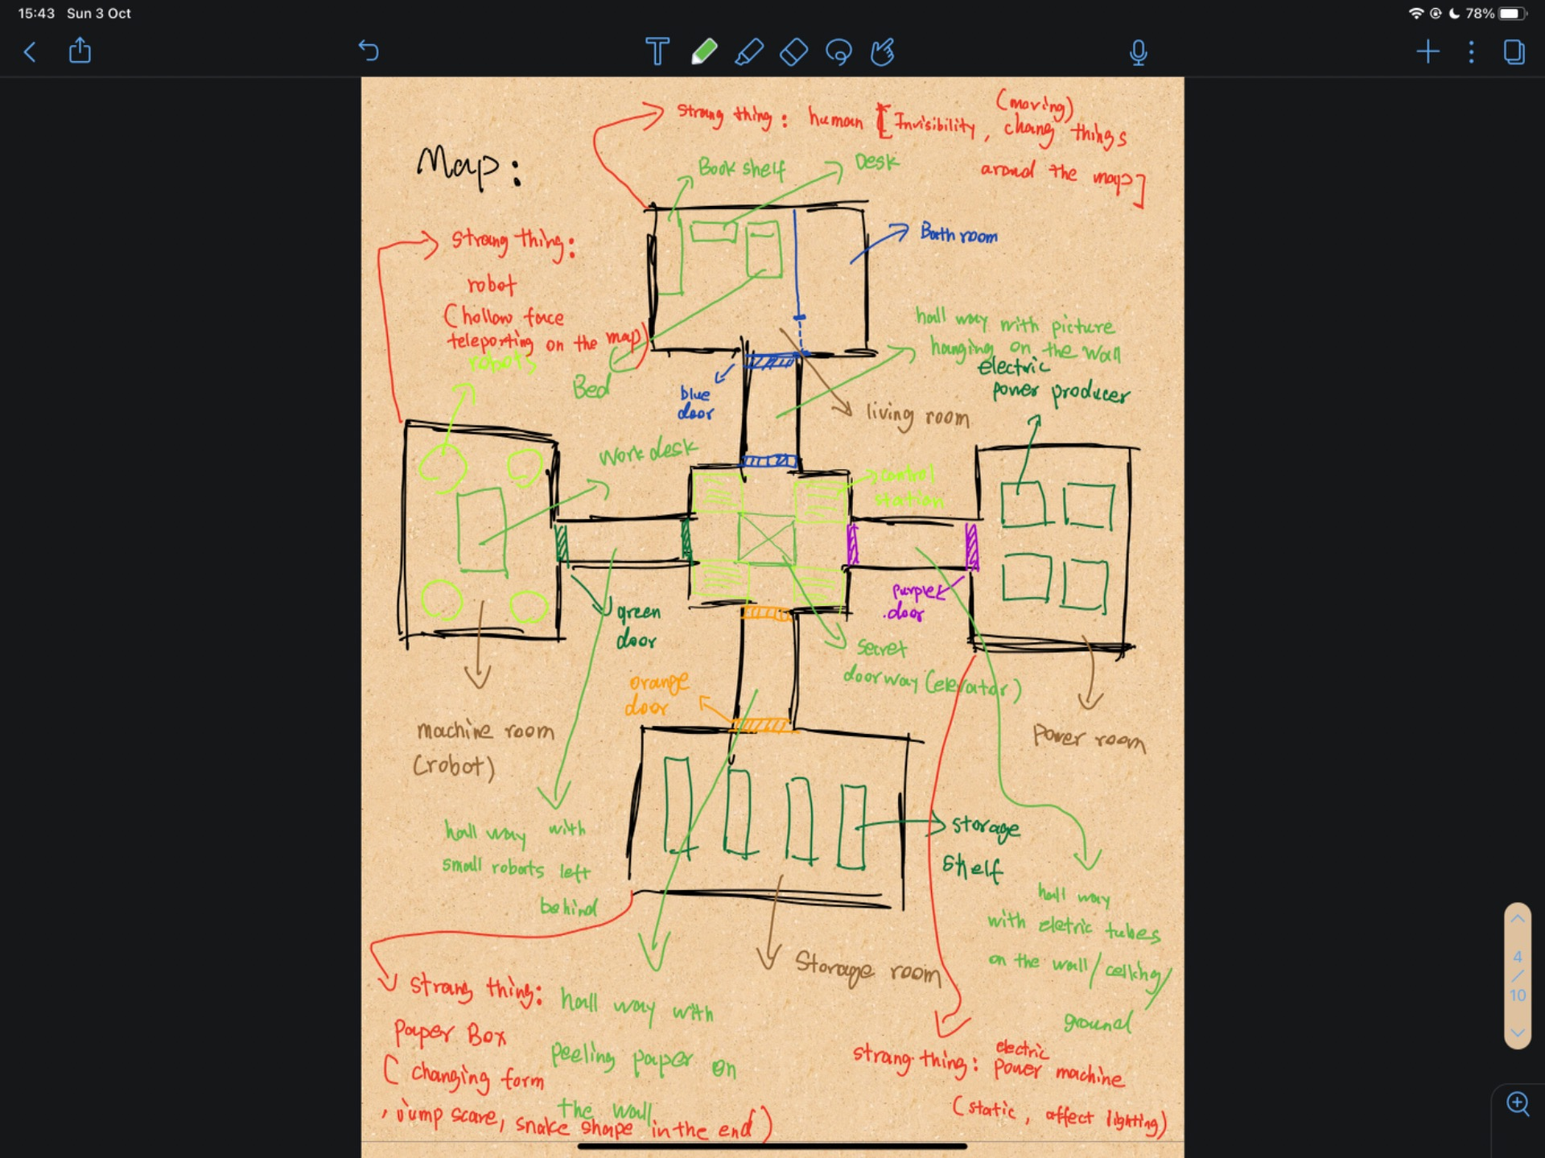
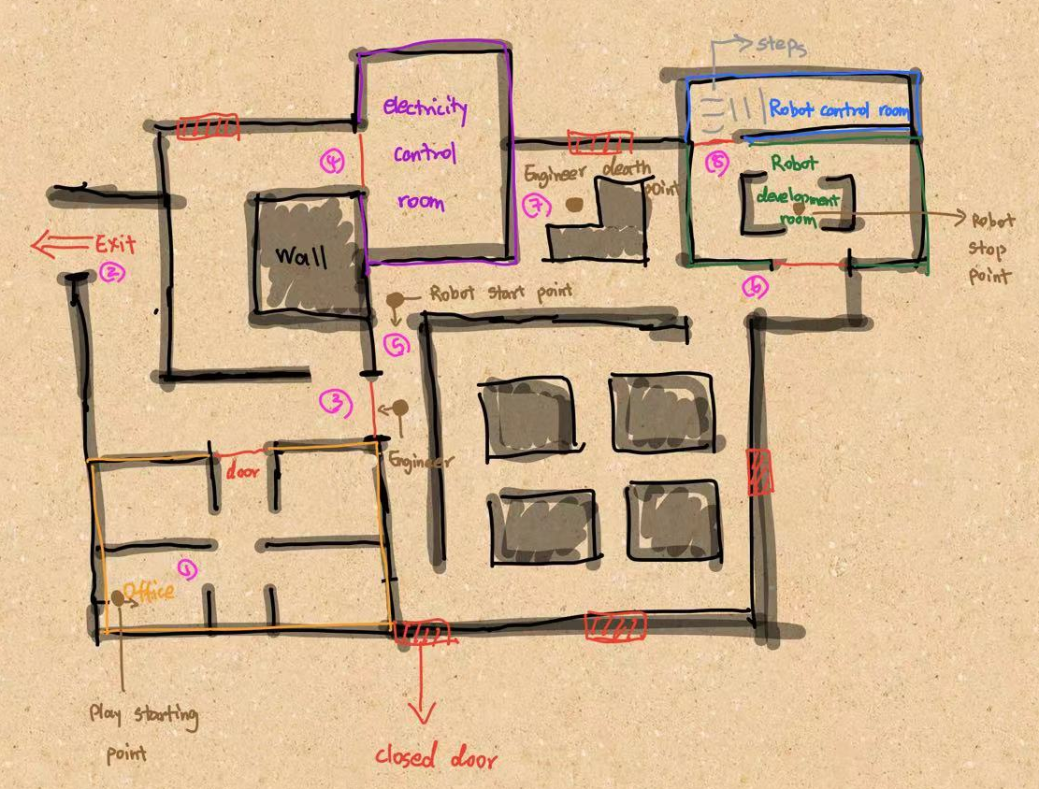
Map Sketch Idea 1 & 2

Slide 6
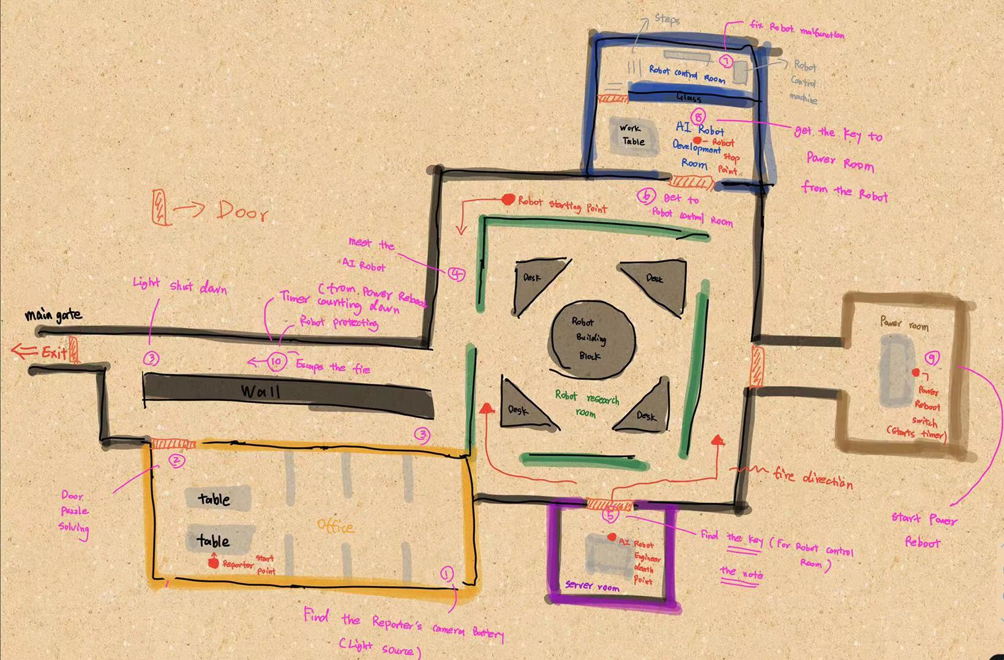
Map Sketch Idea 3 - final
Main Actions & Events
Find battery for camera.
Unlock office door.
Light shut down near main gate.
Robot chasing.
Meet the engineer corpse.
Get the overwrite circuit. &
read the note from the engineer.
Overwrite the robot in its control machine.
Get the key on the robot head.
Use the key on reboot power machine.
Reboot timer starts
Fire start to spread.
Escape from the fire to main gate.
Robot protect the reporter.
Reboot end & the reporter escape through the main gate.

Slide 7
Game Genres
Puzzle solving
Escaping
Survival and horror

Slide 8
Gameplay Mechanics
Search & find – the battery, rooms, etc…
Puzzle solving, use the right combination to unlock door, note reading, etc…
Robot chasing, fire spreading, player escape, electrocuted and burned on touch.

Slide 9
Thanks for watching!

